Slide 1
Weekly Monitoring
From 09/06 to 19/06
Lucas

Slide 2
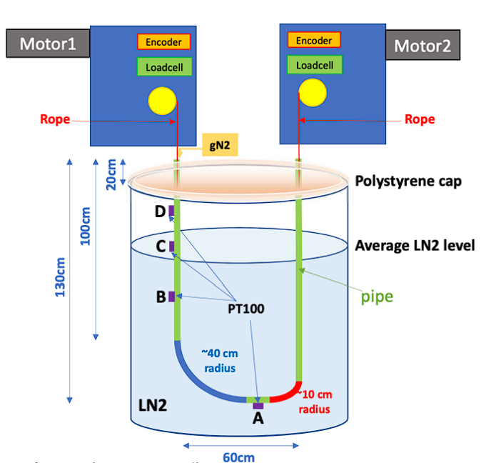
Summary :
Date | Hour | Ice Formation | °C | Tension (N) | %LN2 in tank | gN2 flow (L/h) | Voltage (V) | Current (A)
Fri - 06/09 | 18:00 | Yes | A,B,C LN2 D ~-170° | DS2: 17 DS4: 6 | 98% | >250 (no T) | V2 : 24 V4 : 24 | I2 : 0.08 I4 : 0.08
Sat - 06/10 | 14:31 | Yes, more for DS2 | A,B,C LN2 D -127° | DS2: 17.5 DS4: ~8 | 92% | 250 (no T) | V2 : 24 V4 : 24 | I2 : 0.09 I4 : 0.08
Sun - 06/11 | 14:53 | DS2 Only LN2 for DS4 | A,B,C LN2 D -108° | DS2: ? DS4: ? | 86% | 250 when arrive, 120 now (no T) | V2 : 24 V4 : 24 | I2 : 0.09 I4 : 0.08
Mon - 06/12 | 09:10 | Same | A,B,C LN2 D -100° | DS2: 7 DS4: 15 | 81% | 110 when arrive, 120 now (no T) | V2: 24 V4: 24 | I2 : 0.09 I4 : 0.08
Tue - 06/13 | 11:06 | Seems less on DS2 | A,B,C LN2 D -177.6° | DS2: 6 DS4: 16 | 90% | 250 L/h, (T) | V2: 24 V4: 24 | I2 : 0.09 I4 : 0.09
Wed – 06/14 | 9:12 | Same | A,B,C LN2 D -144° | DS2: 7 DS4: 16 | 95% | 120 L/h, (T) | V2: 24 V4: 24 | I2 : 0.09 I4: 0.08
Thu – 06/15 | 9:15 | Same | A,B,C LN2 D -117° | DS2: 5 DS4: 5 | 89% | Same | Same | Same
Fri – 06/16 | 9:20 | Same | A,B,C,D LN2 | DS2: 5 DS4: 5 | 99,6% | 110 when arrive, 120 now (T) | Same | Same
DS4
(left)
DS2
(right)

Slide 3
Summary :
Date | Hour | Ice Formation | °C | Tension (N) | %LN2 in tank | gN2 flow (L/h) | Voltage (V) | Current (A)
Mon – 19/06 | 9:35 | Same | A,B,C LN2 D -103°C | DS2: 4 DS4 : 4 | 83% | 120 (T) | 24 both | 0,08 both
Tue – 20/06 | 9:15 | Same | A,B,C,D LN2 | DS2: 5 DS4: 5 | 100% | 120 (T) | 24 both | 0,08 both
Wed – 21/06 | 9:44 | Same | A,B,C LN2 D -150 | Same | 96 | 120 (T) | 24 both | Same
Thu – 22/06 | 9:10 | Same | A,B,C LN2 D -180 | Same | 96 | 120 (T) | Same | Same
DS4
(left)
DS2
(right)

Slide 4
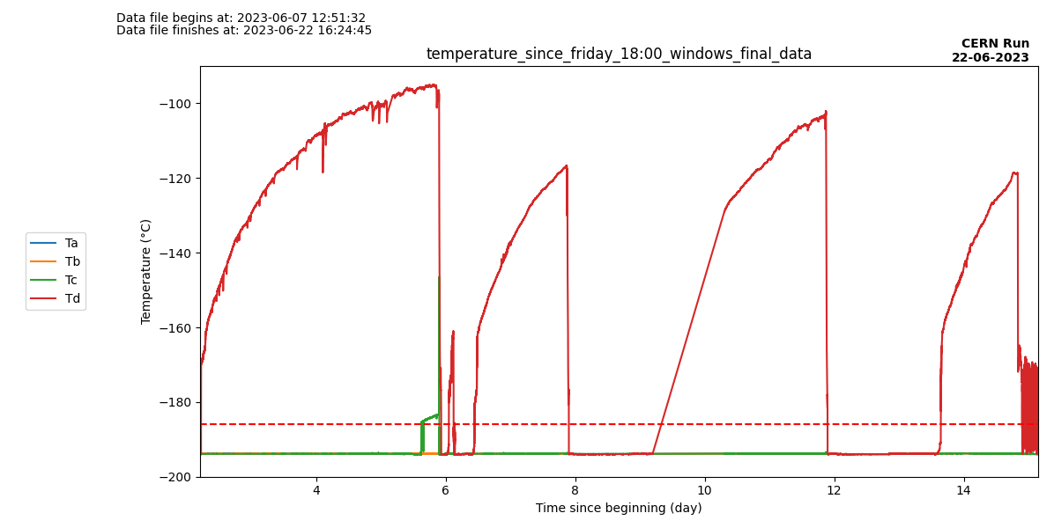
Temperature changes since Friday 6PM
Tank refills
LAr Temperature

Slide 5
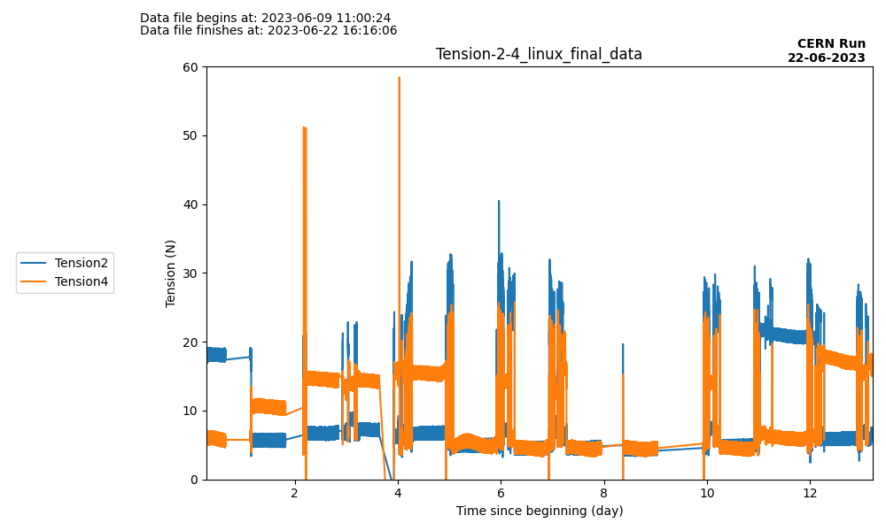
Tension changes since Monday 9AM

Slide 6
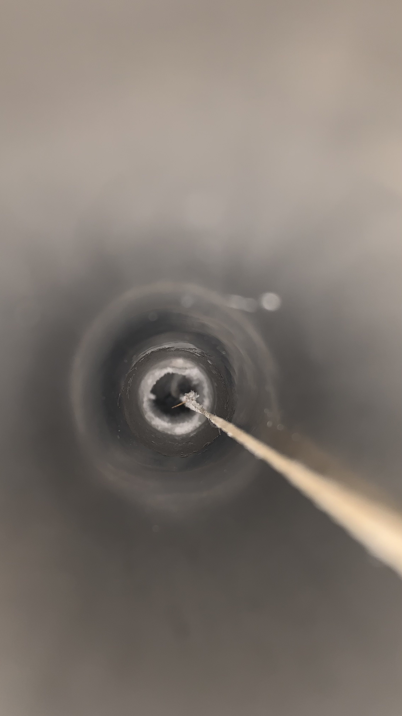
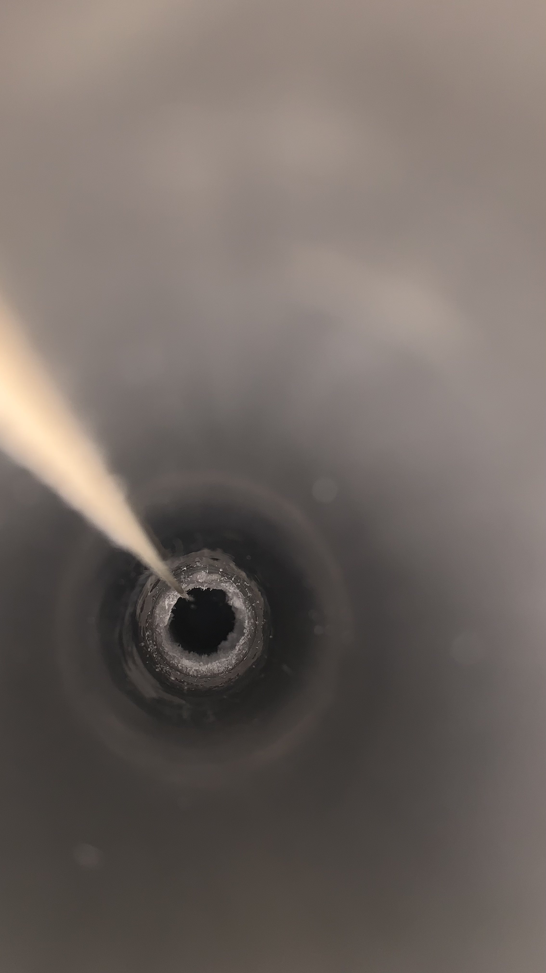
Commentaries : Friday - 06/09 18:00
Peter and Pascal was there, no other commentary needed.
Picture from the top of the left tube
Picture from the top of the right tube

Slide 7
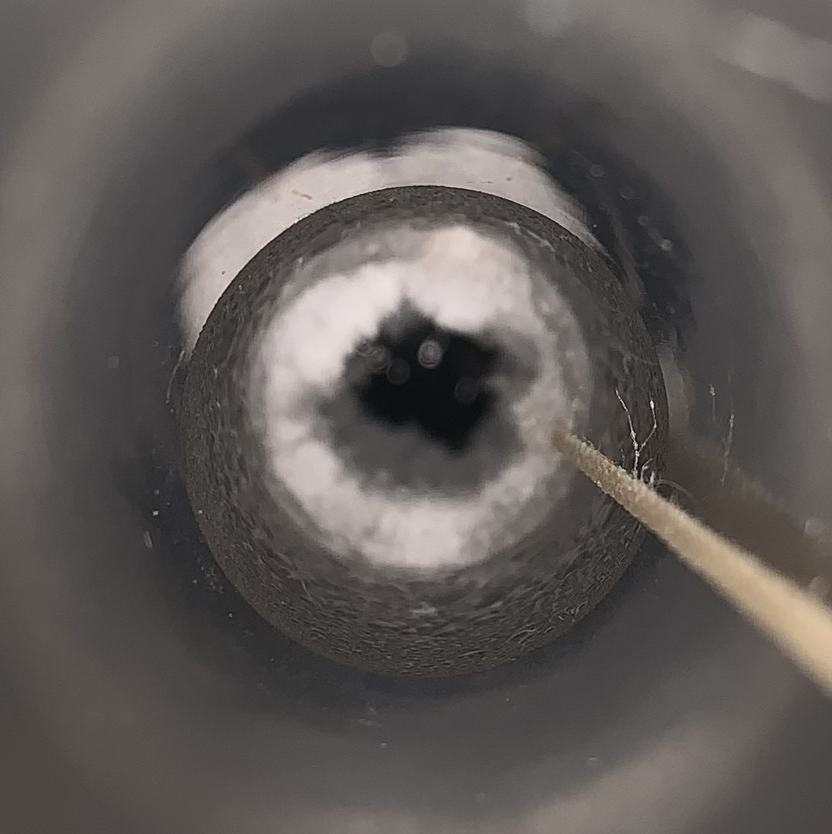
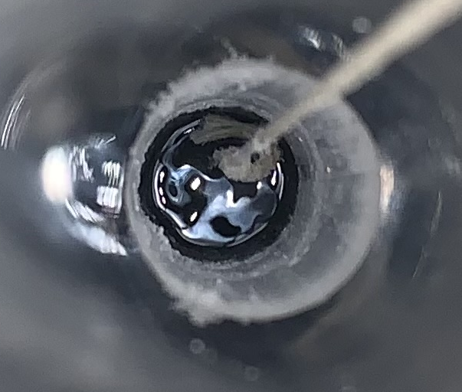
Commentaries : Saturday - 06/10 14:31
Seems to have LN2 at the bottom of the tube : might prevent ice formation ? Need to check tension inside.
I thought ice was blocking the source, but by checking tension it seems fine.
Every other parameter seems fine.
Cryo level dropped by 5% in 20h. So ~6%/day ? I’ll check on Sunday
Monitoring for motors stopped around 2AM (on Saturday). I had to put it back on.
Picture from the top of the left tube
Picture from the top of the right tube

Slide 8
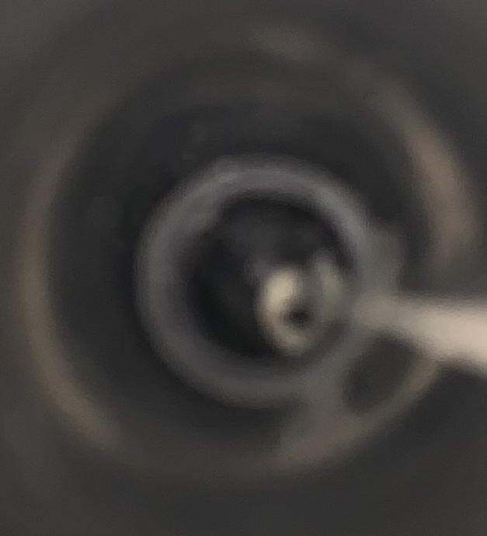
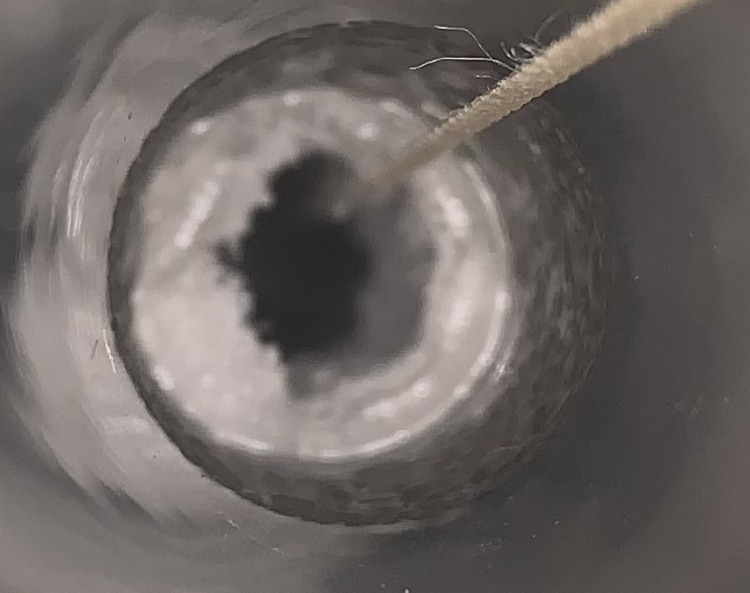
Commentaries : Sunday - 06/11 14:53
Monitoring stopped again at 6:45 AM. 16h 16min from the start. It was ~15h yesterday. The program seems to stop around those time (15h after starting).
By forgetting to put the lid on the left tube, the plastic cap blocked the pulley and stop the movement. Fixed it by relax, putting rope back on pulley then locate and move it back to its position.
6% less LN2 in the tank. So, it seems 6%/day.
Liquid air inside tube, around 50cm from the top (position 570).
Every other parameters seems fine
Picture from the top of the left tube
Picture from the top of the right tube

Slide 9
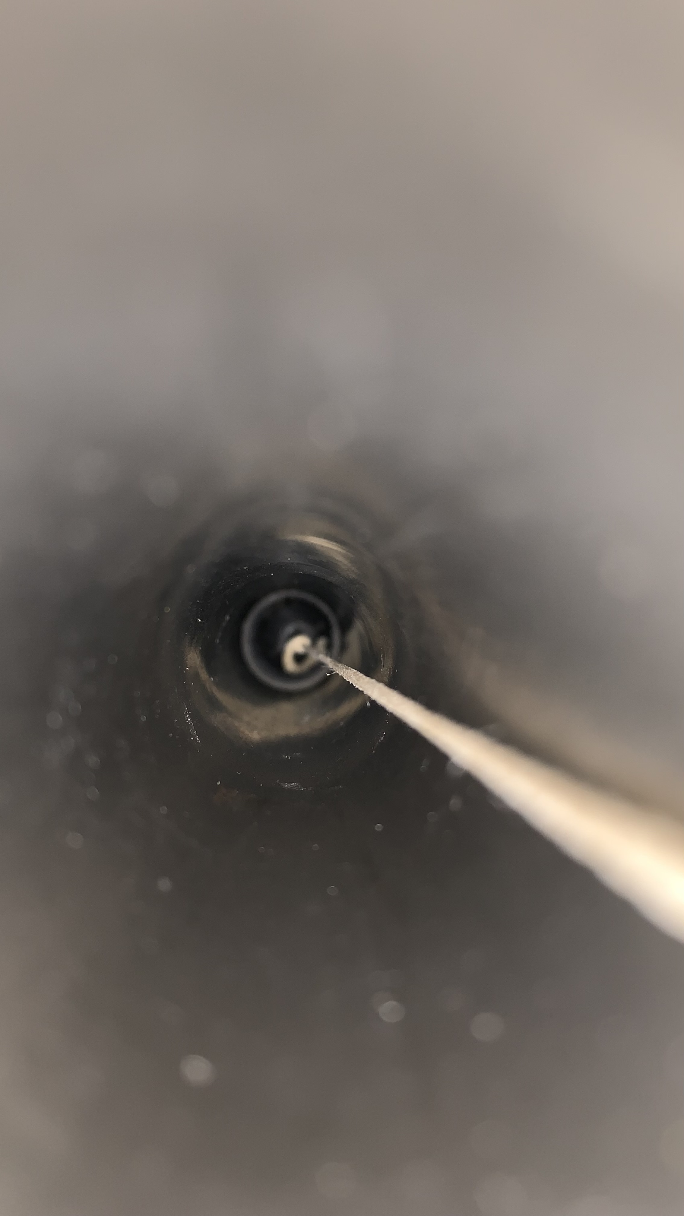
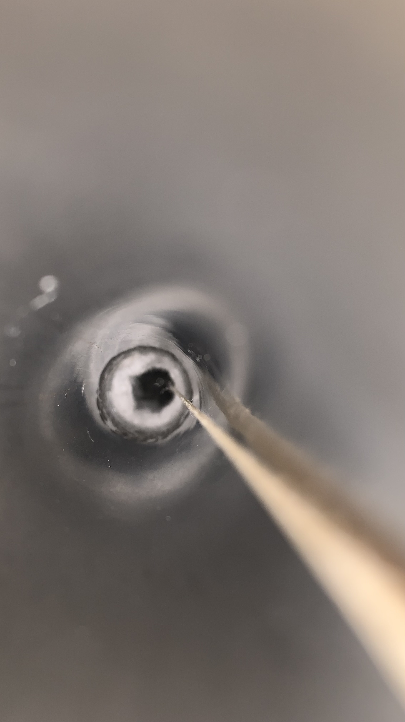
Commentaries : Monday - 06/12 09:10
Monitoring stopped again at 4:44 AM.
5% less LN2 in the tank. So, it seems 6.6%/day.
When flushing with Laetitia (put gN2 at 250 and block air exit on left side), some liquid was seen on the right side.
Every other parameters seems fine
Picture from the top of the left tube
Picture from the top of the right tube

Slide 10
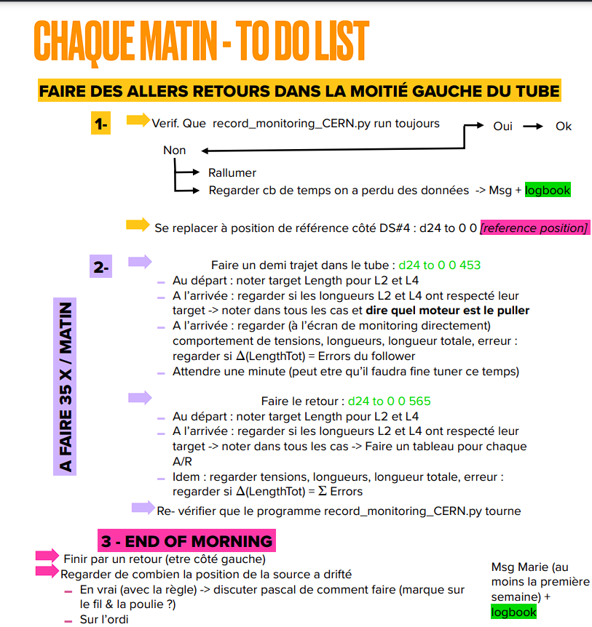
Commentaries : Tuesday - 06/13
Monitoring stopped again at 2:27 AM.
When putting the source at the hot garage, the gN2 tube was stuck. Tension rose at 60N. Relax then take off plastic cap. Shorten the gN2 pipe inside tube (more than 10cm was inside).
Some ice seems to have formed into the left tube (DS4). Maybe too much manipulation (to take pictures, to measure LN2 inside the tube …) increased humidity.
I started the morning program from Marie’s slides. Took 3 hours to complete. Forgot to take the last data to check the drift (I restarted the program before, so data unusable).
Laetitia filled the tank almost completely.

Slide 11
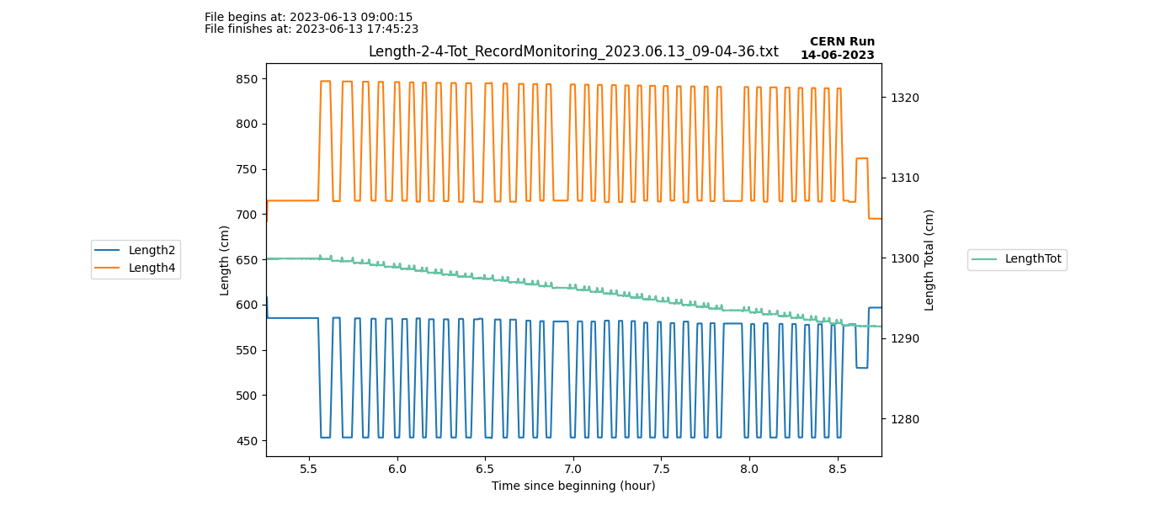
Length on “Morning Routine” 13/06

Slide 12
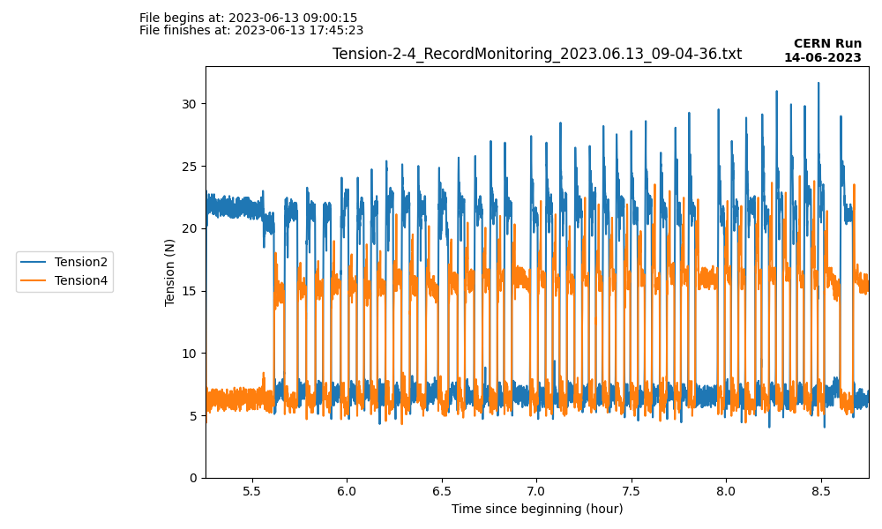
Tension on “Morning Routine” 13/06

Slide 13
Commentaries : Wednesday - 06/14
Pression from battery outside : 150 bar. Need to talk again with Laetitia but seemed ok to her yesterday.
Seems like there is the same amount of ice in both sides. Maybe too much opening of the tube and humidity went inside.
I’ll be checking the ice formation only twice a day to prevent humidity getting inside.
Morning routine went fine. Took 2h30. Tension went to 30 for DS2 (sometimes 27, sometimes 32). Around 20 for DS4. Maybe need to talk about this together because it’s kinda high for DS2.
Drift after the morning routine : ~6cm

Slide 14
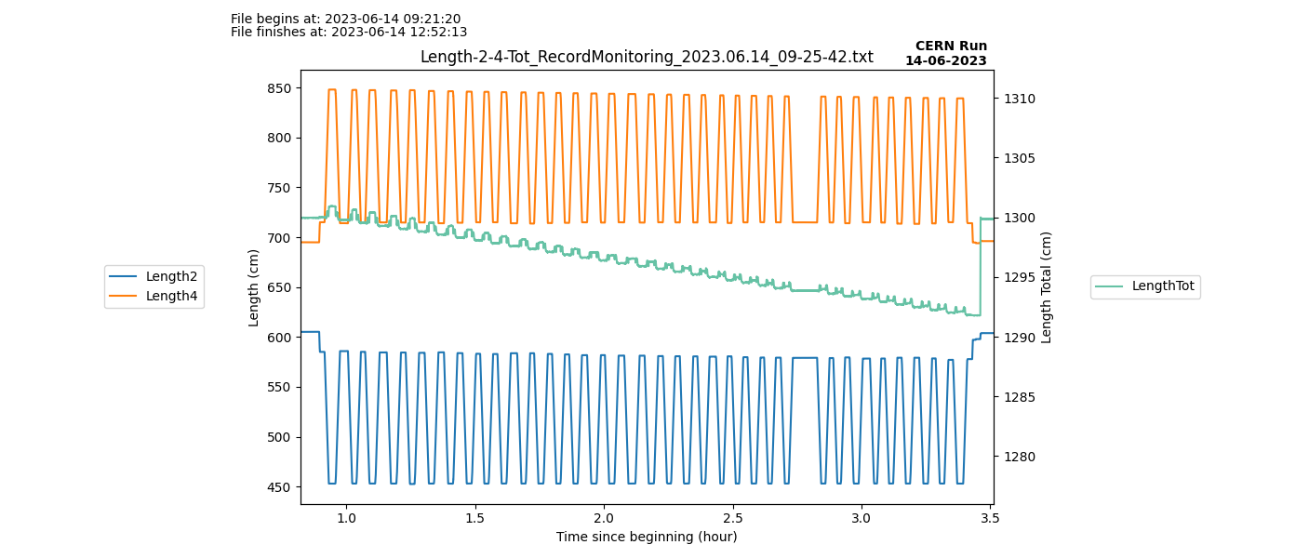
Length on “Morning Routine” 14/06
Locate

Slide 15
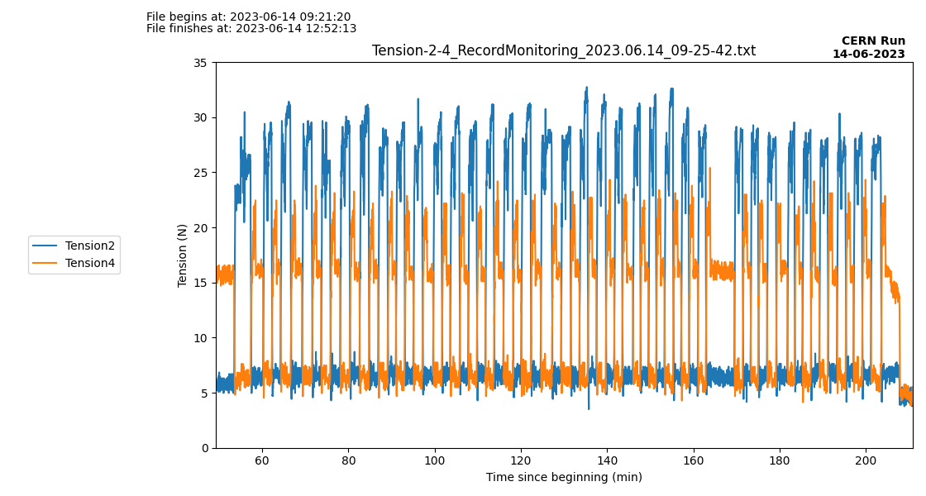
Tension on “Morning Routine” 14/06
Relax

Slide 16
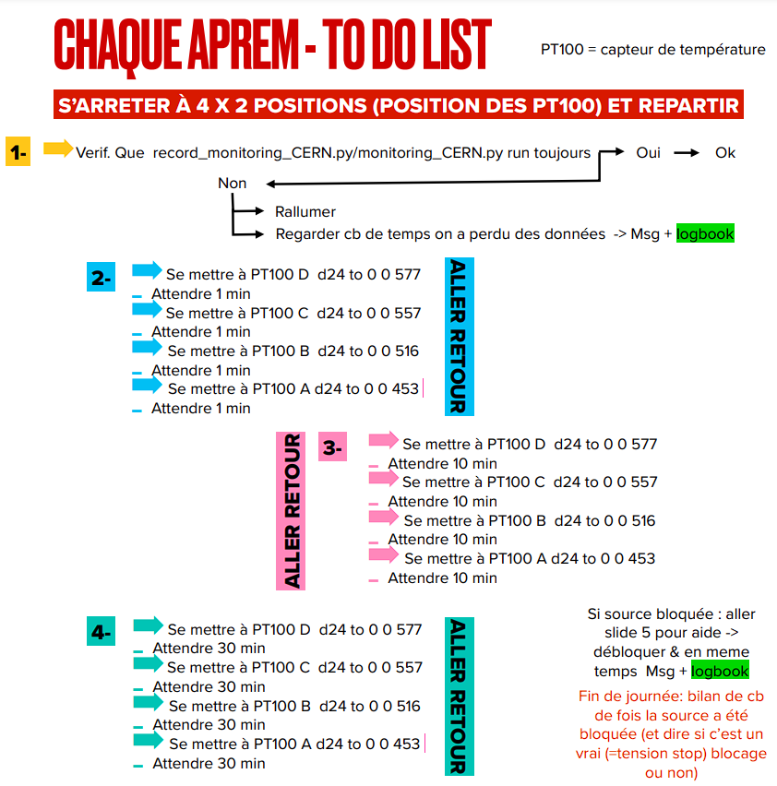
Commentaries : Thursday- 06/15
Pression from battery outside : ~145/150 bar. Laetitia said it’s going to be fine during a month at 120L/h.
Morning routine went fine. Tension went to 40 for DS2 at one time. It was when the source arrived at the destination (453). No clue why.
Error4 was kind of high since the beginning (around 7) but was constant.
Laetitia said we could put LAr at the end of the month but it’s going to take a big week to unfill the tank.
Drift after the morning routine : ~5cm
I stopped the afternoon routine at the “come back”. I’ll add the data tomorrow.

Slide 17
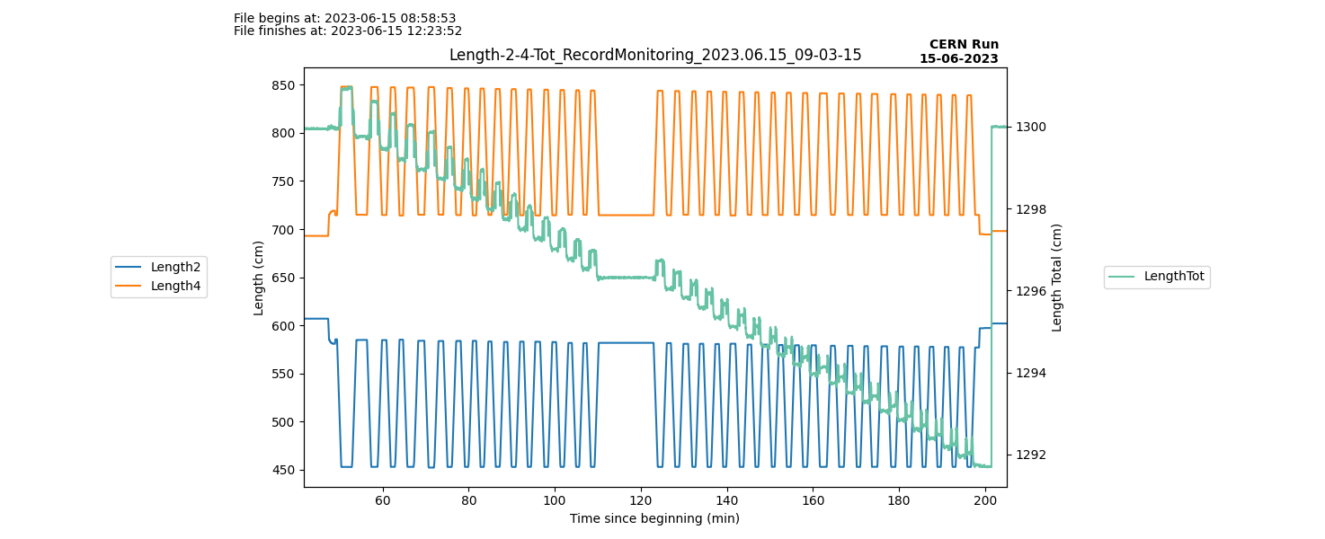
Length on “Morning Routine” 15/06
Locate
Mid break

Slide 18
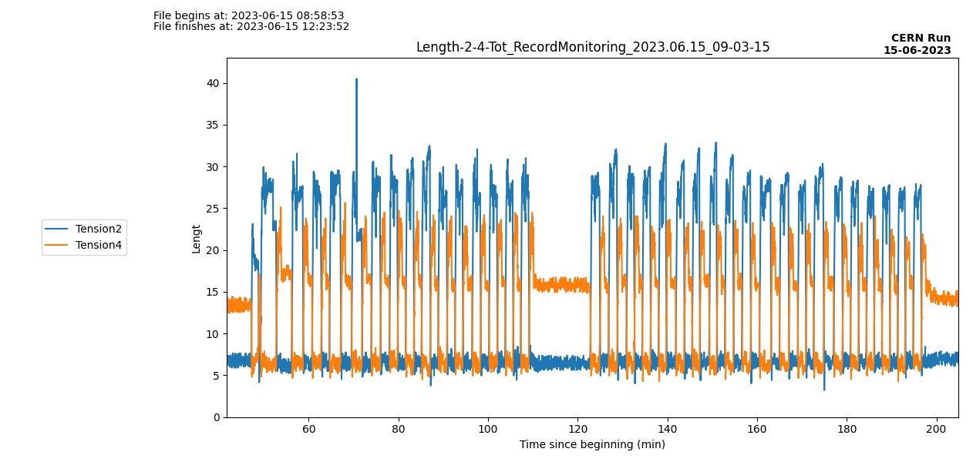
Tension on “Morning Routine” 15/06
Mid break

Slide 19
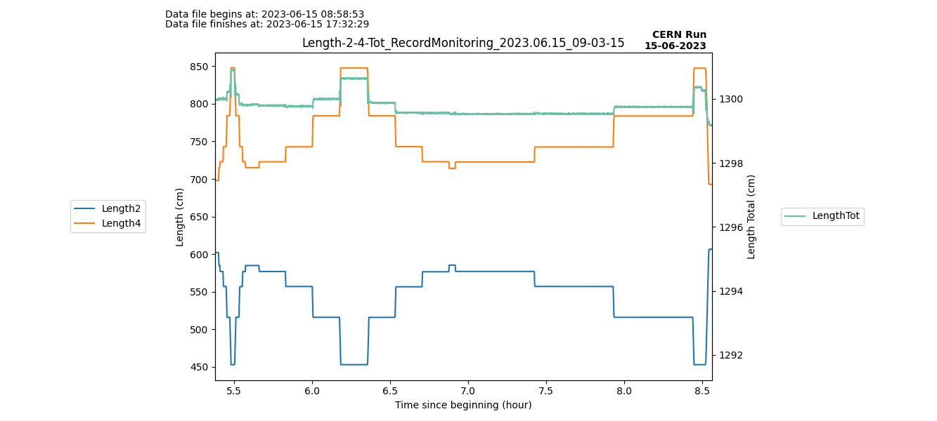
Length on “Afternoon program” 15/06

Slide 20
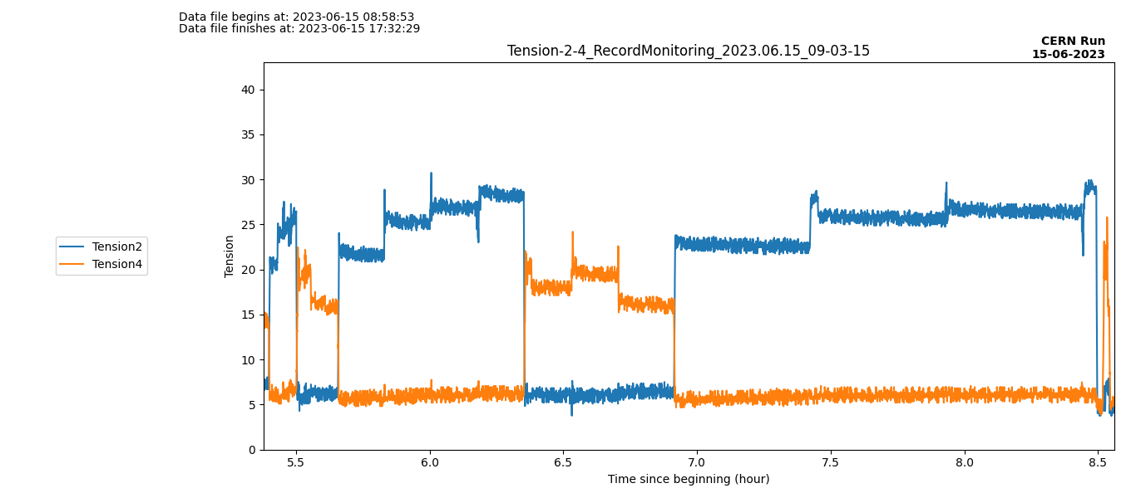
Tension on “Afternoon program” 15/06
Relax but forgot to locate, then relax again

Slide 21
Commentaries : Thursday- 06/16
LN2 in tube at 575, more than before. Maybe the filling of the tank ?
DS4 rope error during the afternoon program (from 453 to 516 at 1’ stops). Located and fixed.
Not enough time to do all the afternoon program (take ~5h30), so yesterday did going frontward and today backward.
I don’t have my USB, so gonna take the windows data (temperatures) tomorrow !

Slide 22
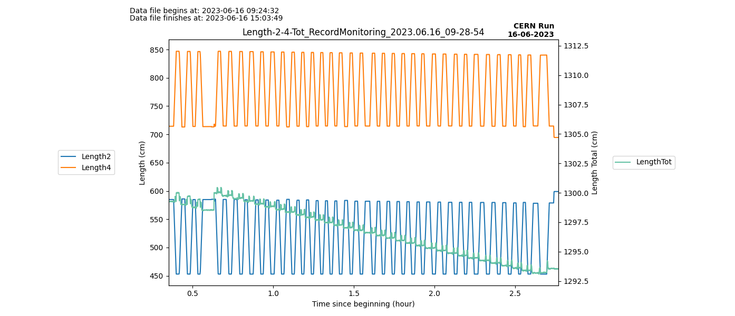
Length on “Morning Routine” 16/06
Locate

Slide 23
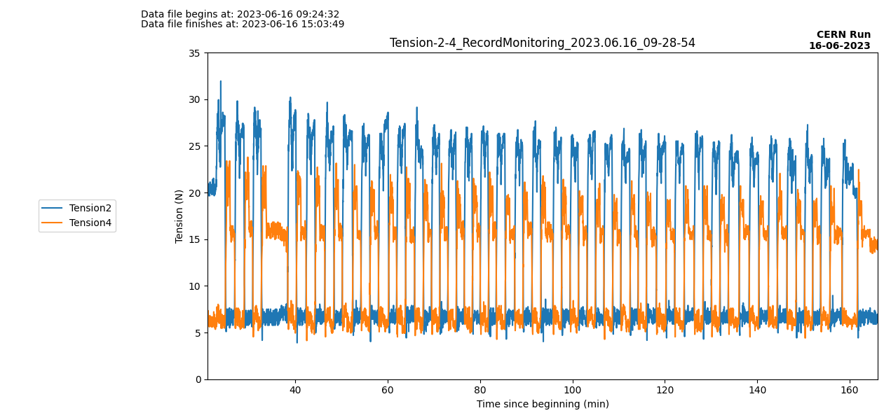
Tension on “Morning Routine” 16/06

Slide 24
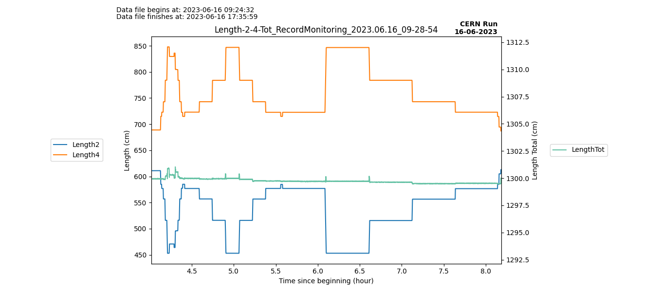
Length on “Afternoon program” 16/06
Located then relaxed

Slide 25
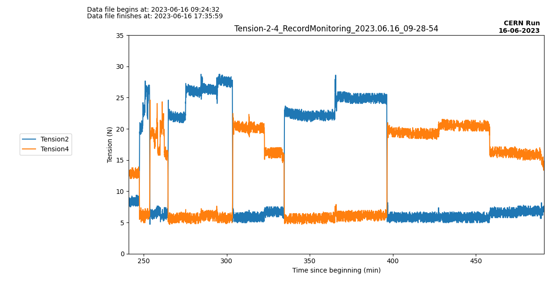
Tension on “Afternoon program” 16/06
Located then relaxed

Slide 26
Commentaries : Thursday- 06/19
In the morning routine, the tension when source is moving to PT100A is higher at the start of the routine (during 5-6 come back). Maybe some frost blocking the source at the beginning ?

Slide 27
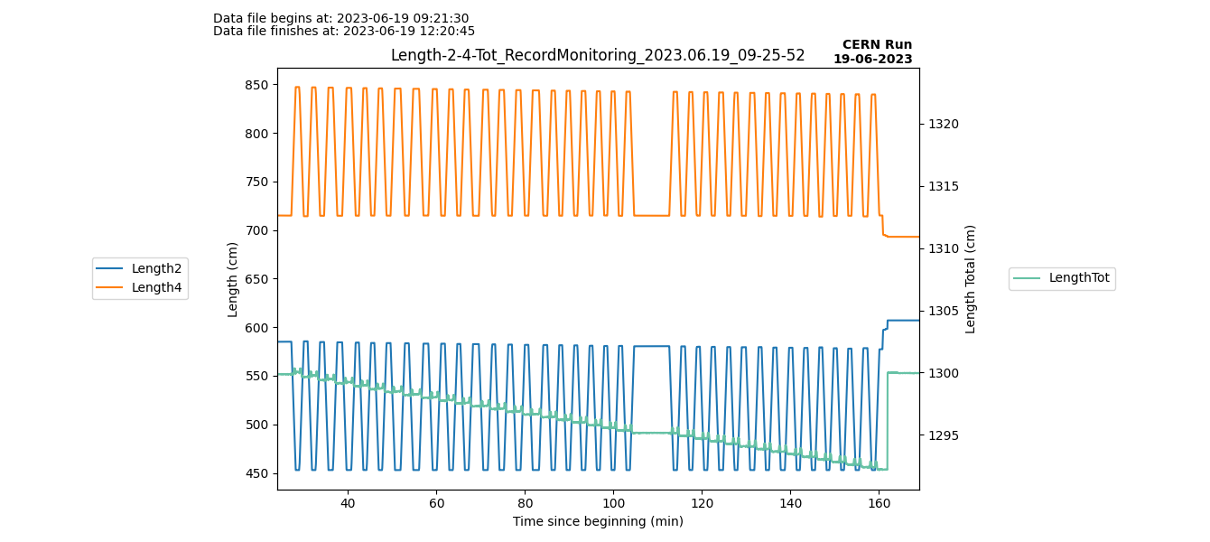
Length on “Morning Routine” 19/06

Slide 28
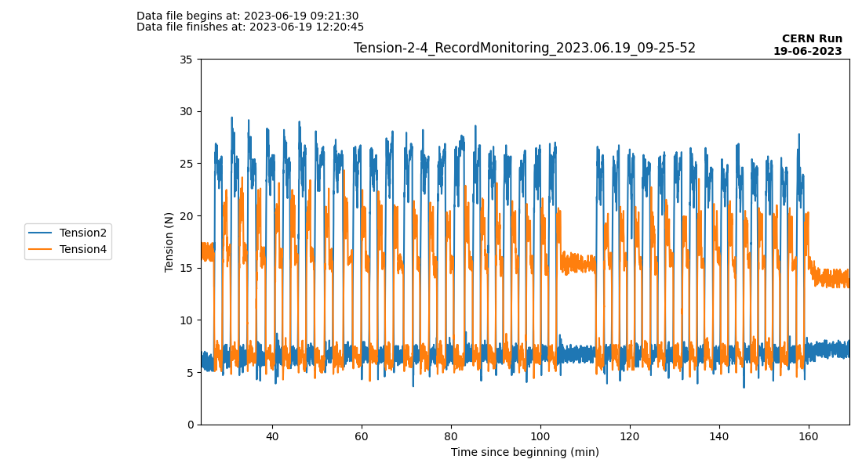
Tension on “Morning Routine” 19/06

Slide 29
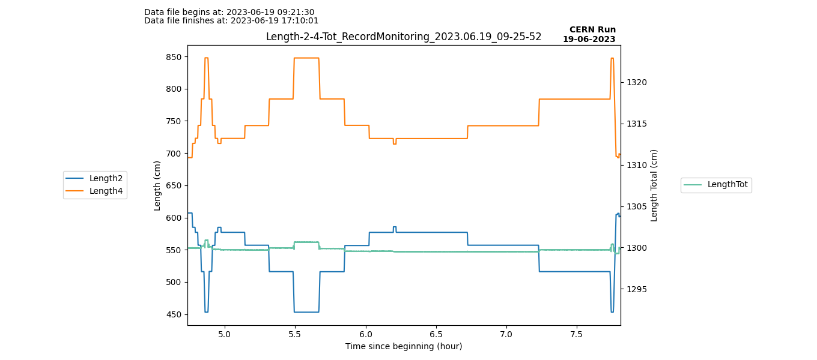
Length on “Afternoon program” 19/06
Located then relaxed

Slide 30
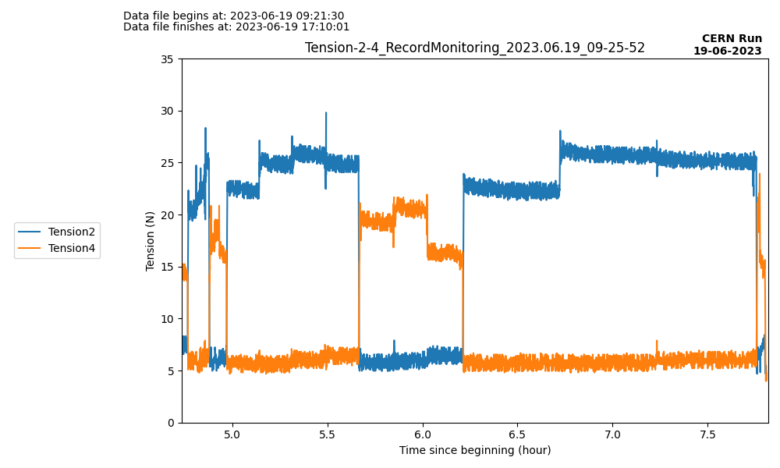
Tension on “Afternoon program” 19/06
Located then relaxed

Slide 31
Commentaries : Thursday- 06/20
Program of this afternoon :
Source at PT100 D for 2h30’
OK
Source at PT100 C for 1h30’
OK
Source at PT100 B for 1h
OK
Source at PT100 A for 1h
OK
Source at PT100 D for all night
OK

Slide 32
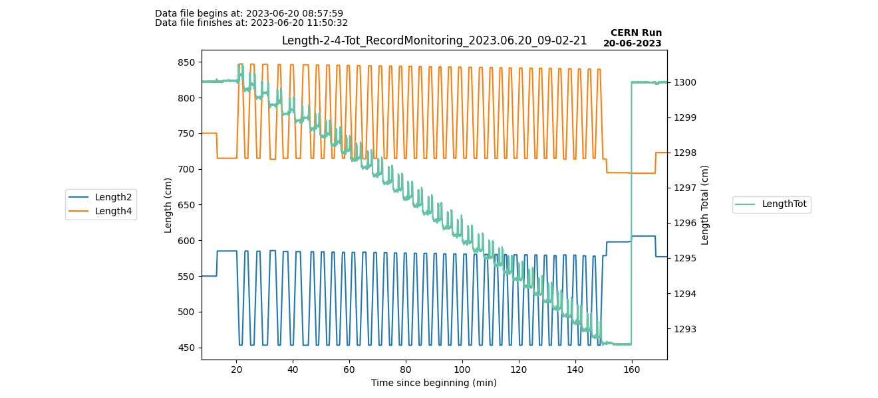
Length on “Morning Routine” 20/06
Locate then start of afternoon program

Slide 33
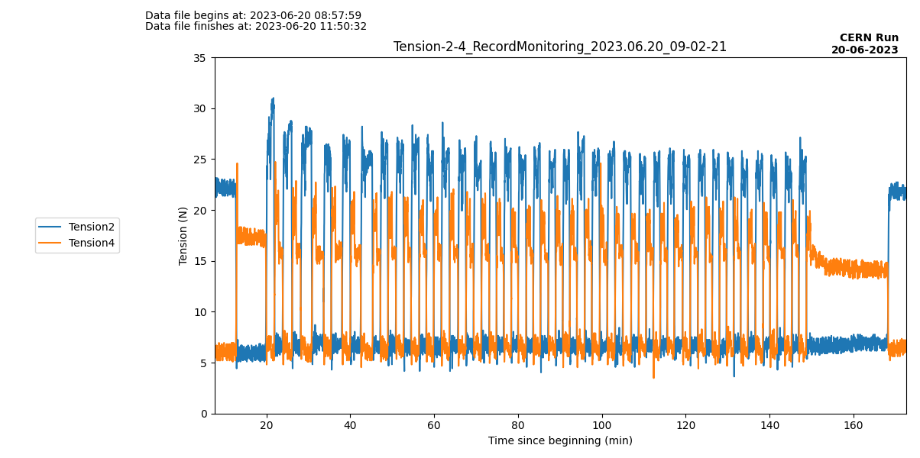
Tension on “Morning Routine” 20/06
Start of afternoon program

Slide 34
Commentaries : Thursday- 06/21
Program of this afternoon :
Source at PT100 D for 2h
OK
Then 10’ normal program
OK
Source at PT100 1 for 1h
OK
Source at PT100 B for 1h
OK
Source at PT100 C for 1h30
OK
. Source at PT100 D for all night
OK

Slide 35
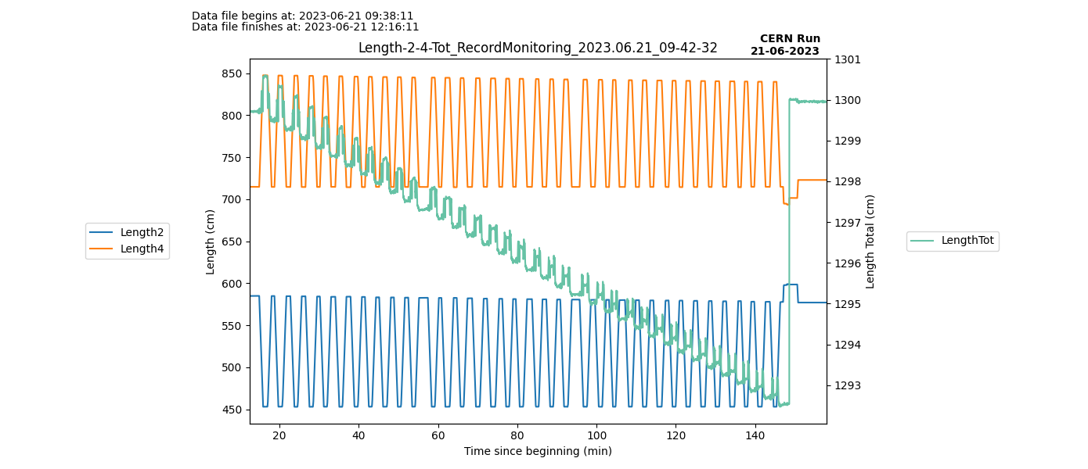
Length on “Morning Routine” 21/06
Locate then start of afternoon program

Slide 36
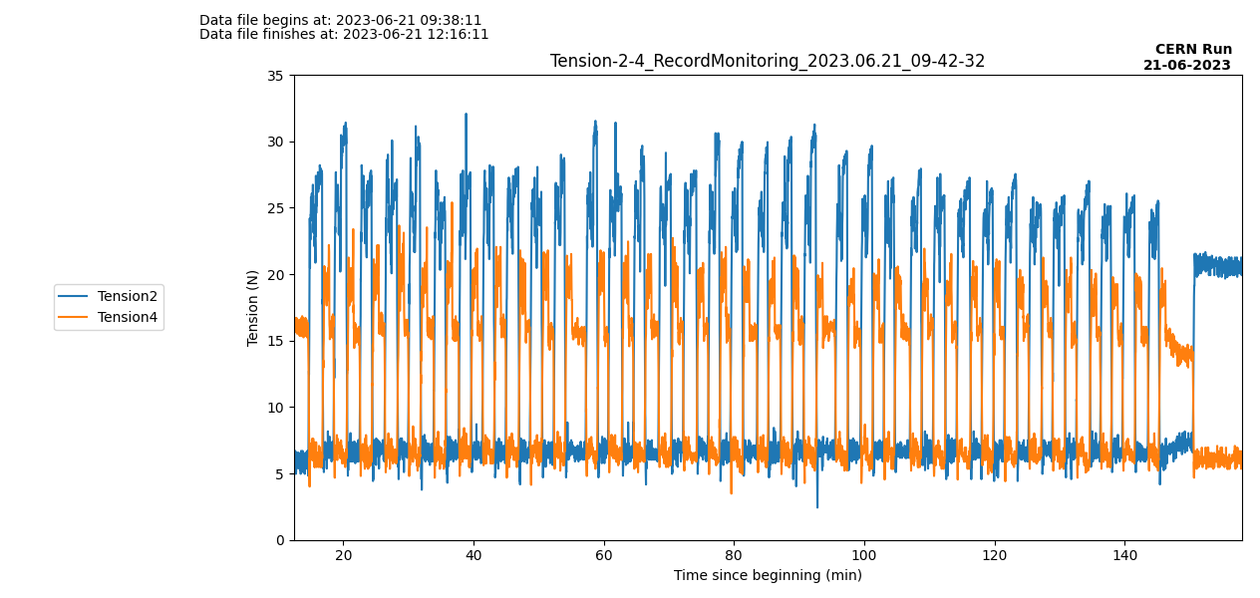
Tension on “Morning Routine” 21/06
Start of afternoon program

Slide 37
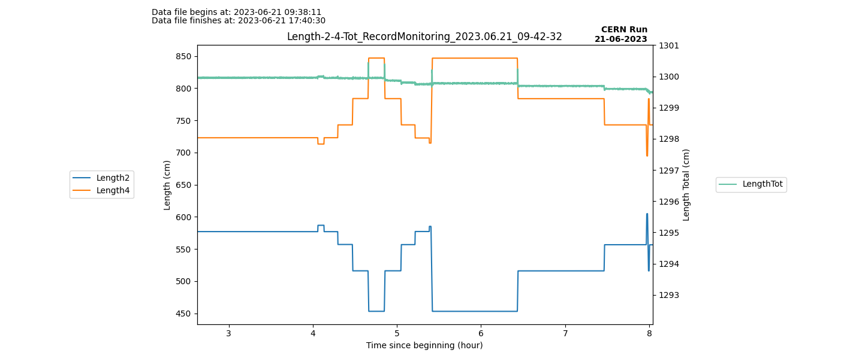
Length on “Afternoon program” 21/06

Slide 38
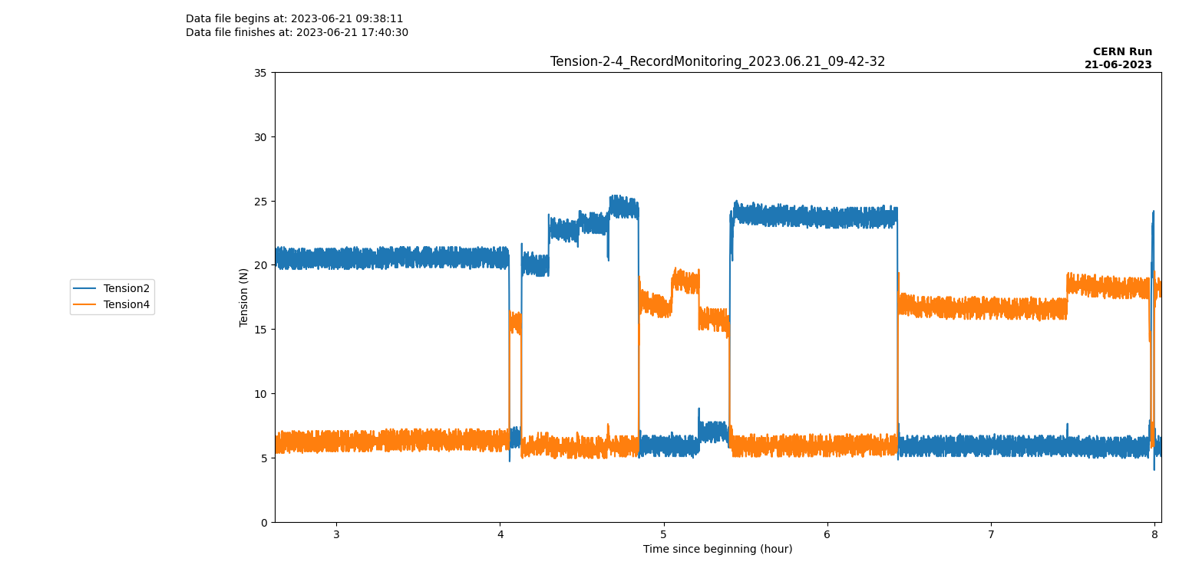
Tension on “Afternoon program” 21/06

Slide 39
Commentaries : Thursday- 06/22
Program of this afternoon :
Source at PT100 B for 1h
OK
Source at PT100 C for 1h
OK
. Source at PT100 D for 1h
OK
Some rapid changes in temperature, need to talk with Laetitia Tomorrow.

Slide 40
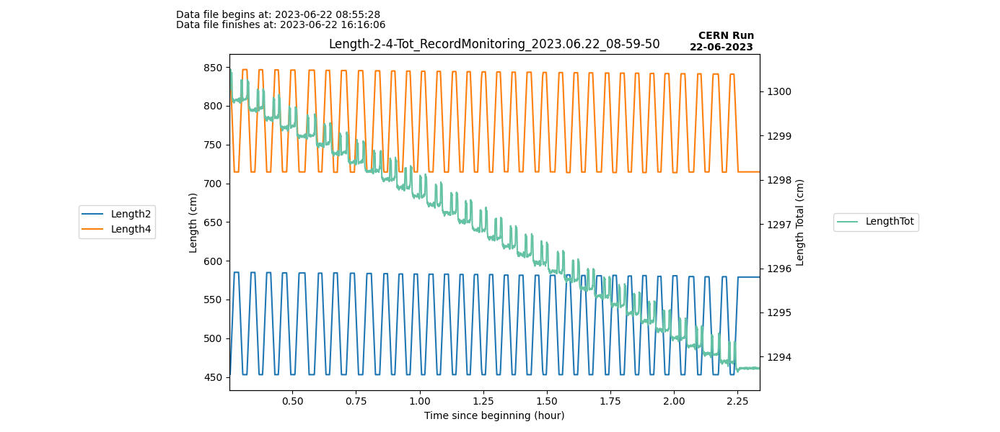
Length on “Morning Routine” 22/06
Locate then start of afternoon program

Slide 41
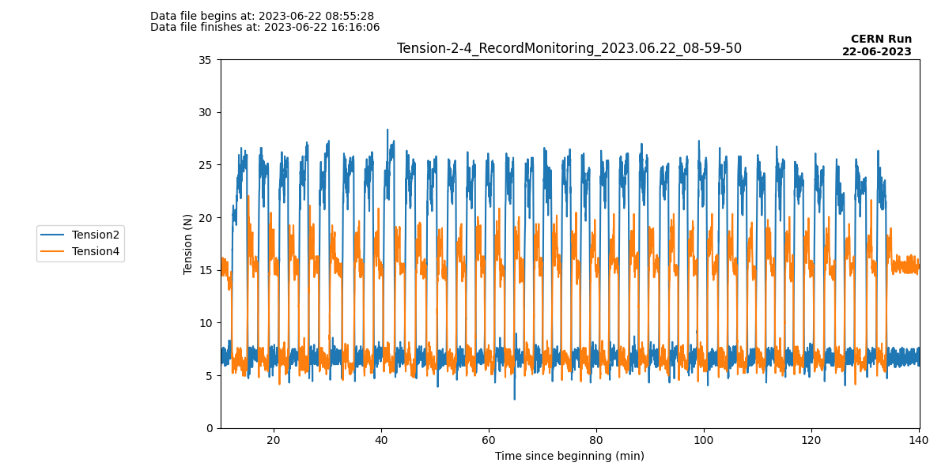
Tension on “Morning Routine” 22/06
Start of afternoon program

Slide 42
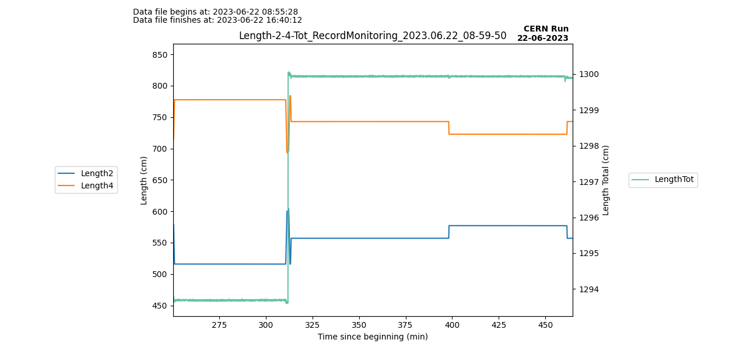
Length on “Afternoon program” 22/06

Slide 43
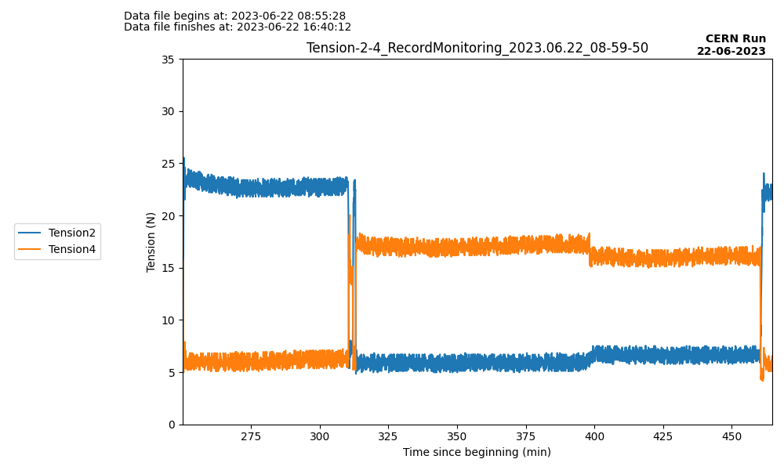
Tension on “Afternoon program” 22/06

Slide 44
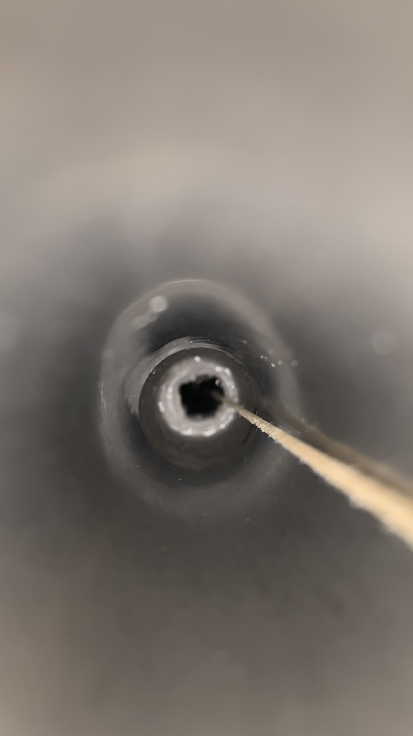
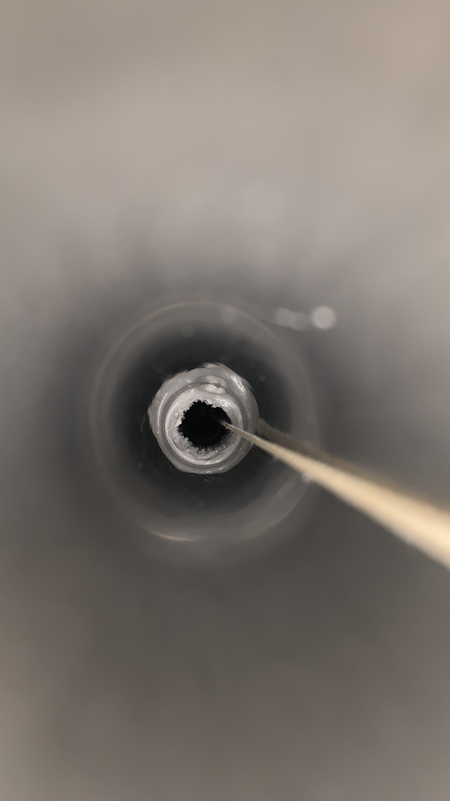
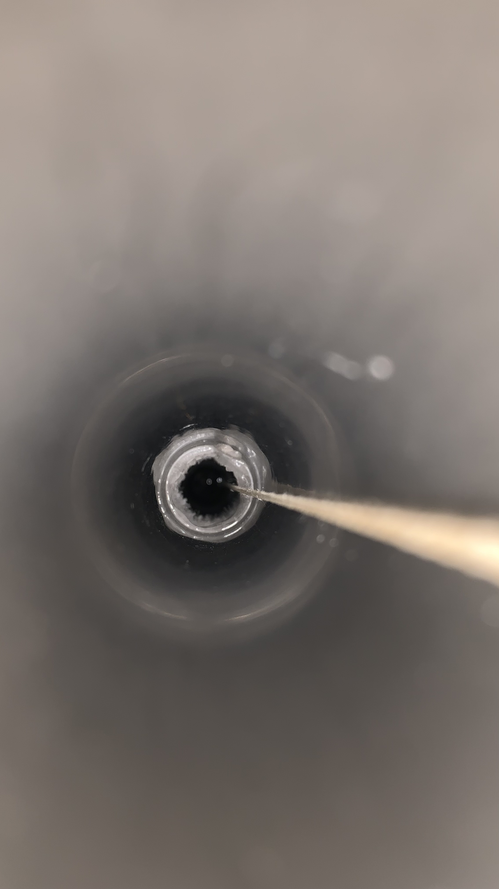
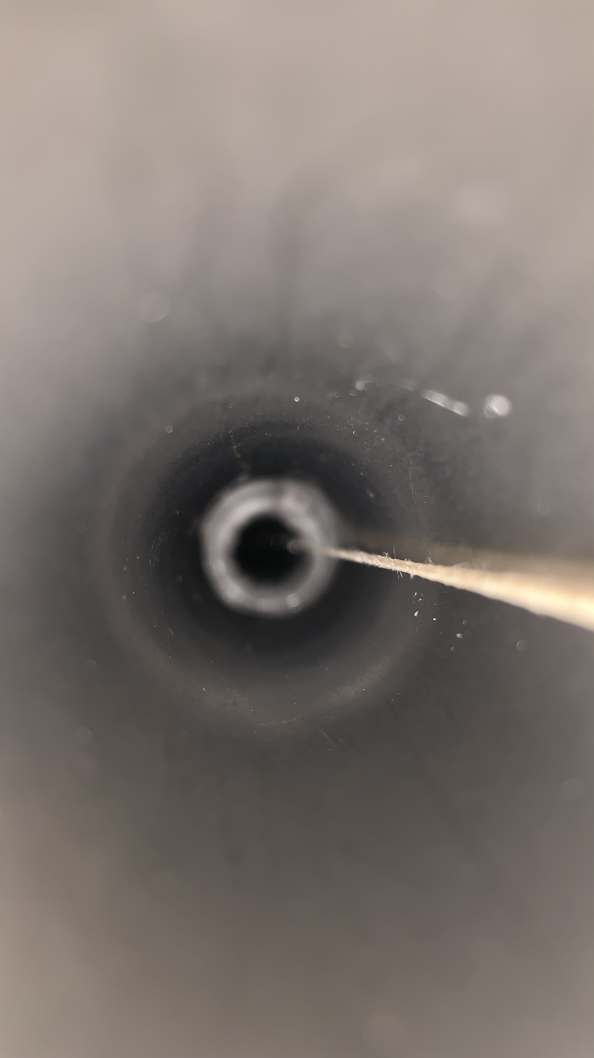
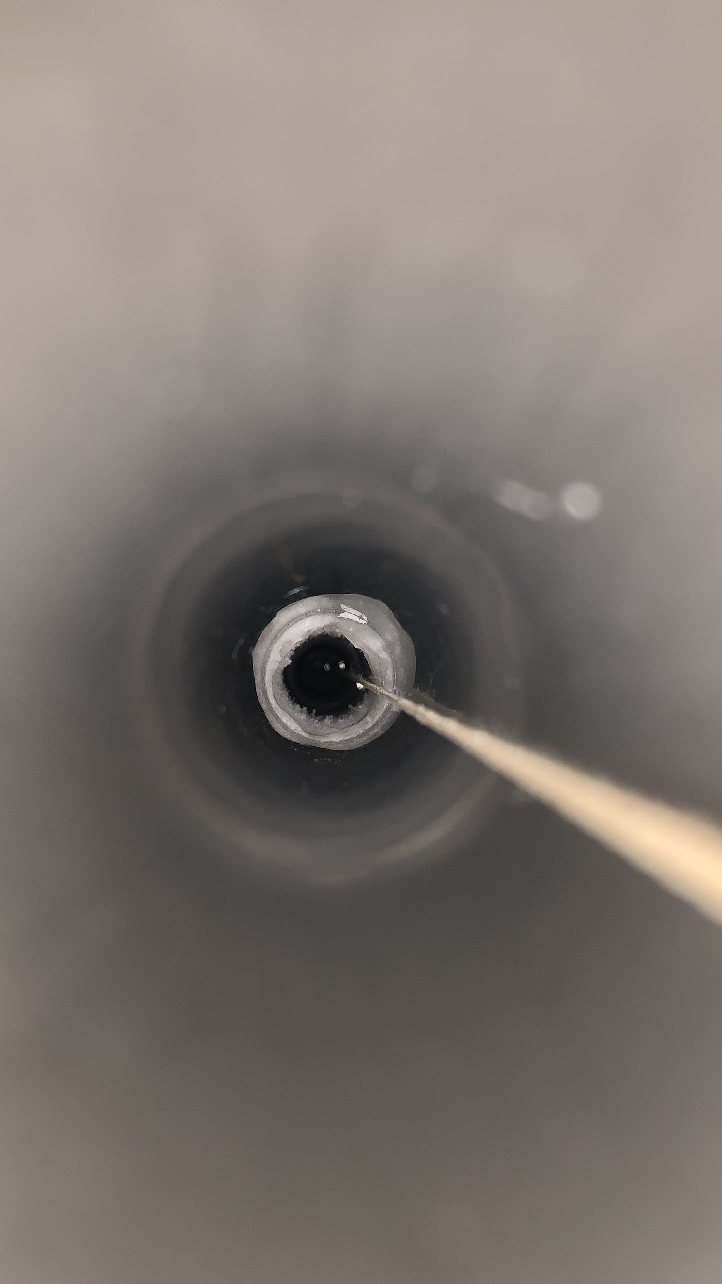
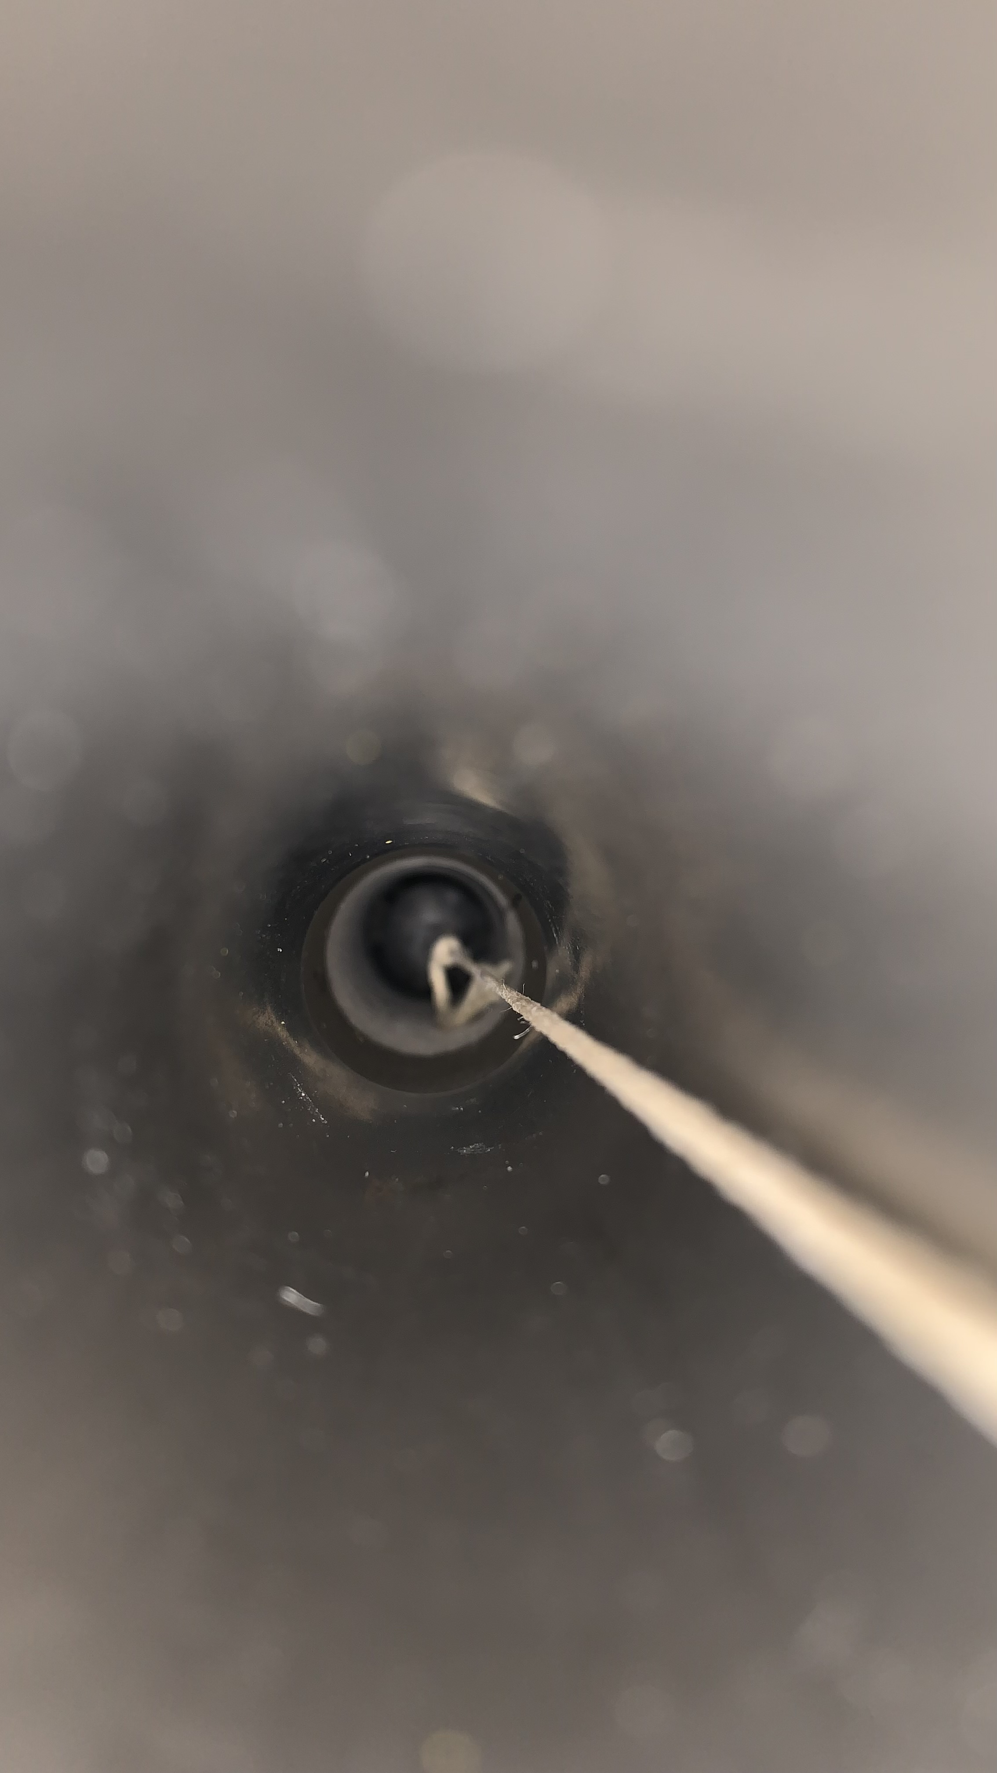
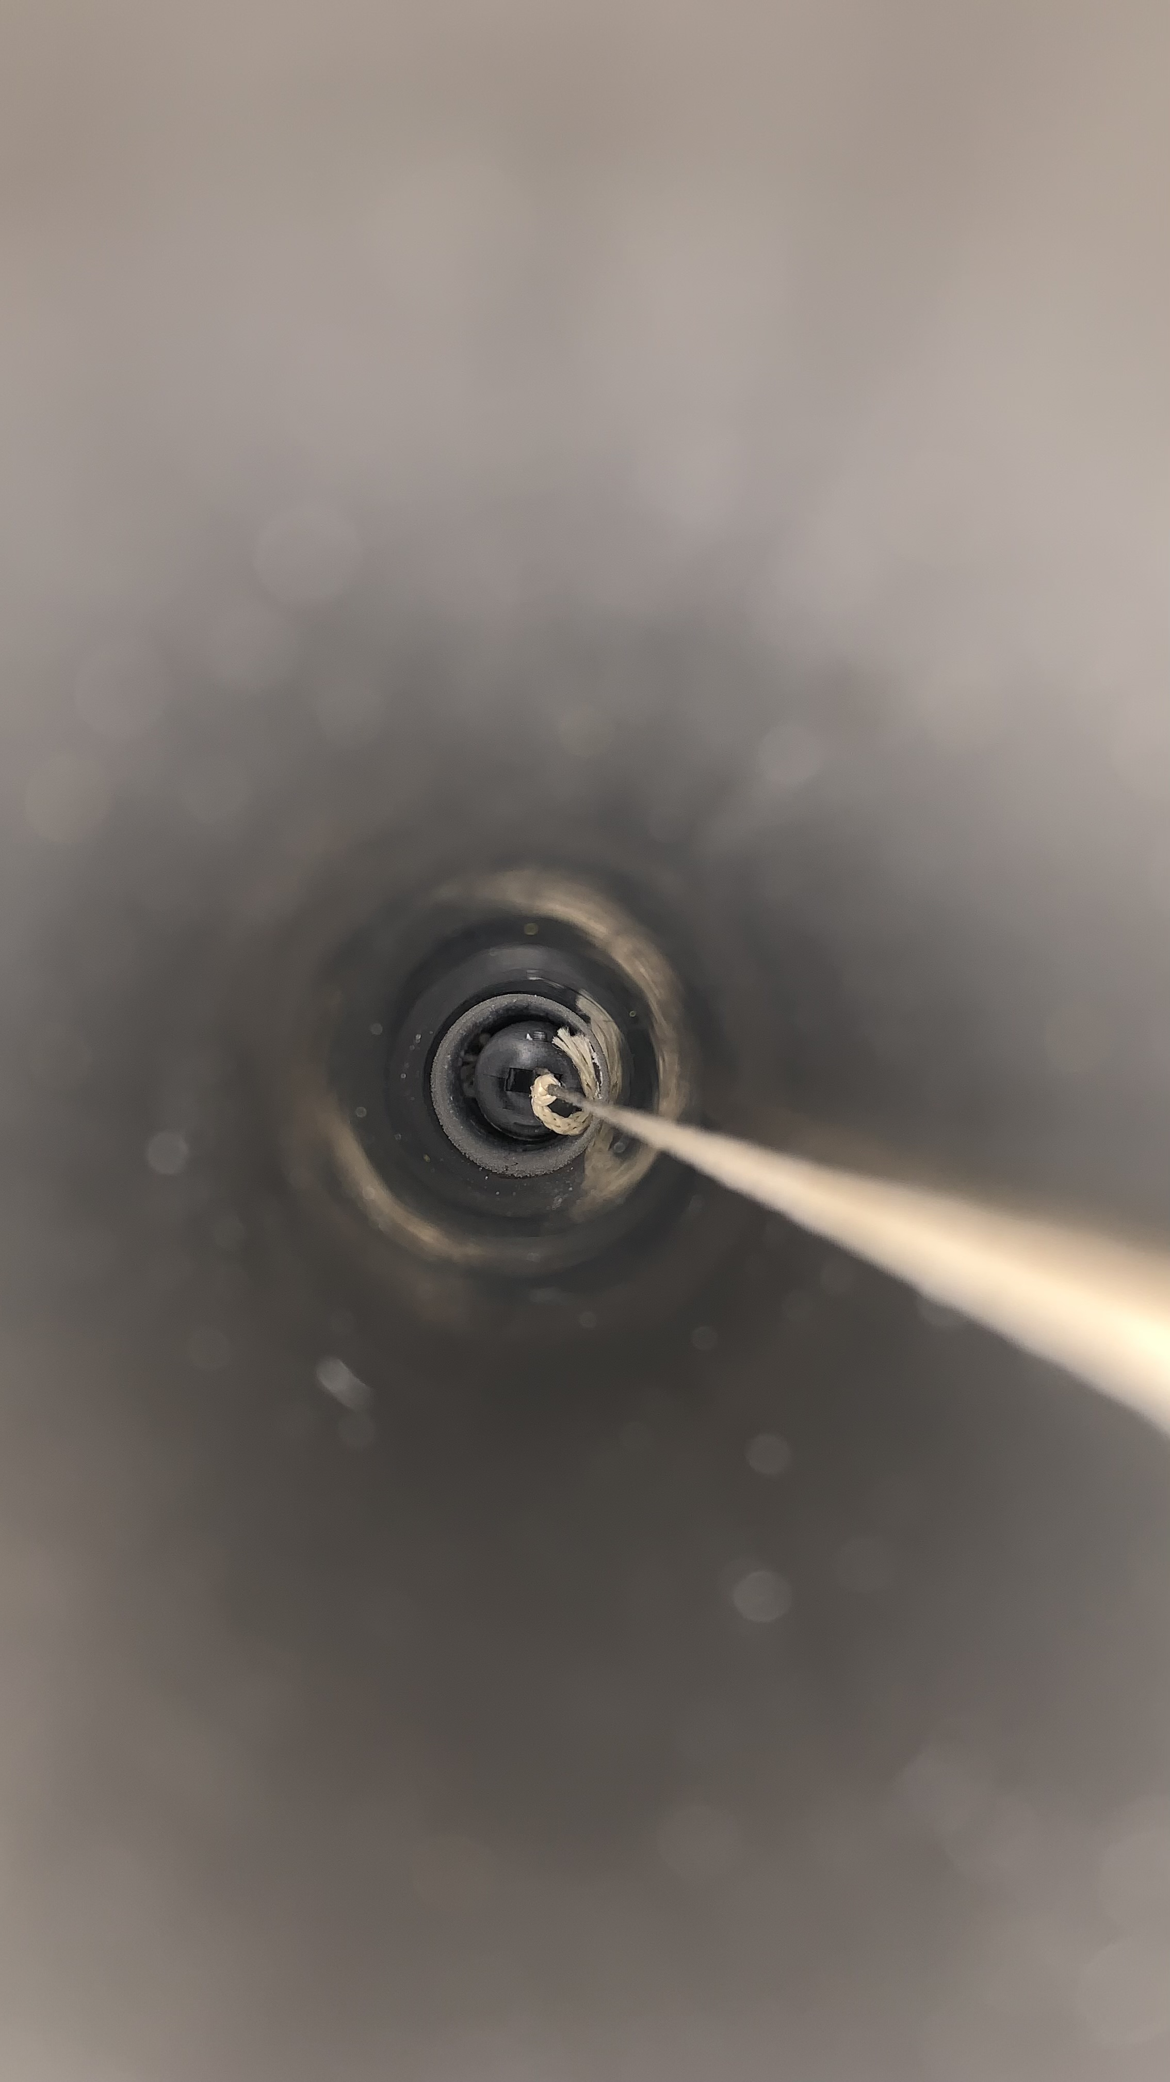
Flushing LN2 to see effect on ice :
Time | 12/06/2023 11:00 | 12:00 | 12:50 | 14:00 | 15:05
Right Side (DS2)
Left Side (DS4)
T shaped gN2 pipe | NO | NO | NO | YES | YES
gN2 Total flow | 250L/h, right side | 250L/h, right side | 250L/h, right side | 250L/h split in both sides | 250L/h split in both sides
LN2 in tube | 56cm from top -> position 564 |  |  |  | 55cm from top -> position 565
%LN2 in tank | 81% | ~ 80% | ~ 80% | ~ 80% | ~ 80%
Pictures are cropped to be visible so do not pay attention on sizes, more on shapes.

Slide 45
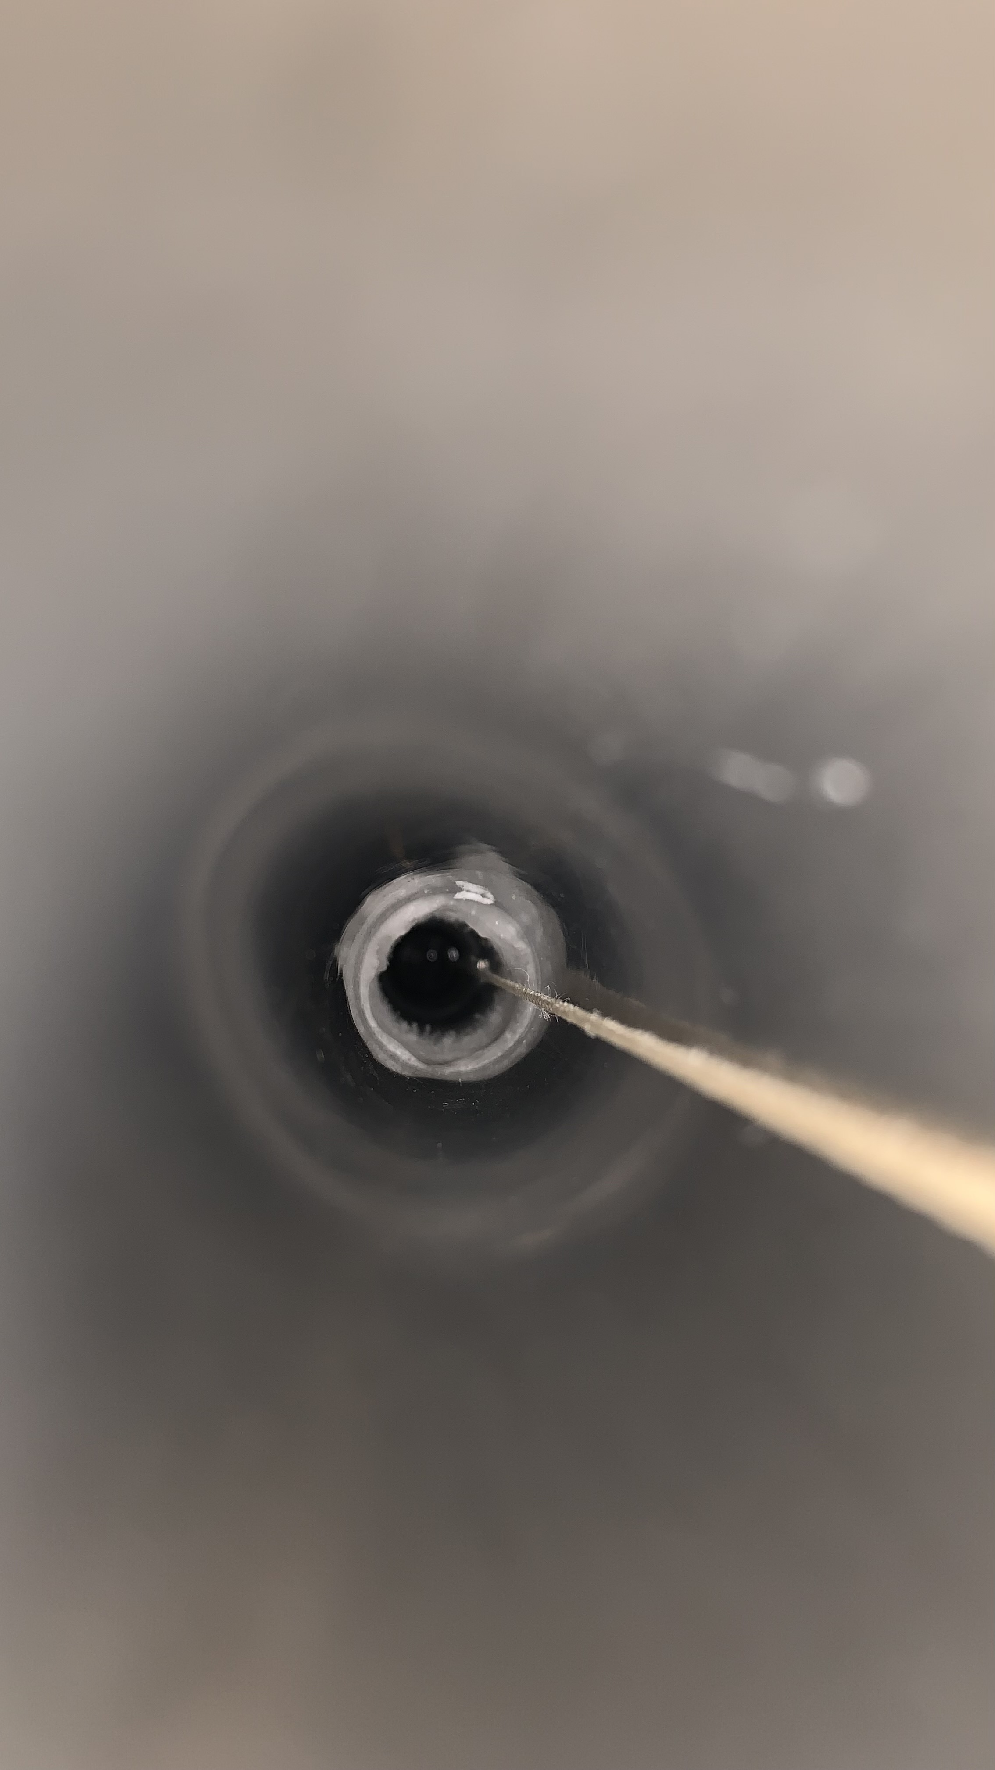
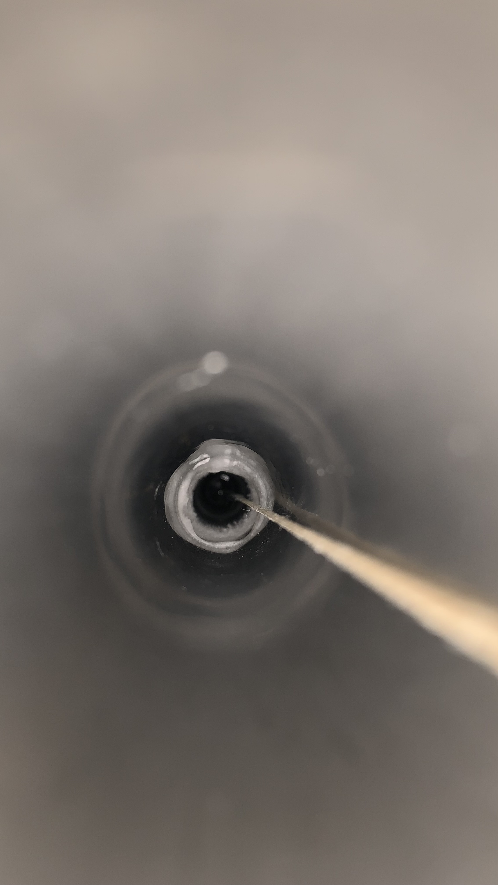
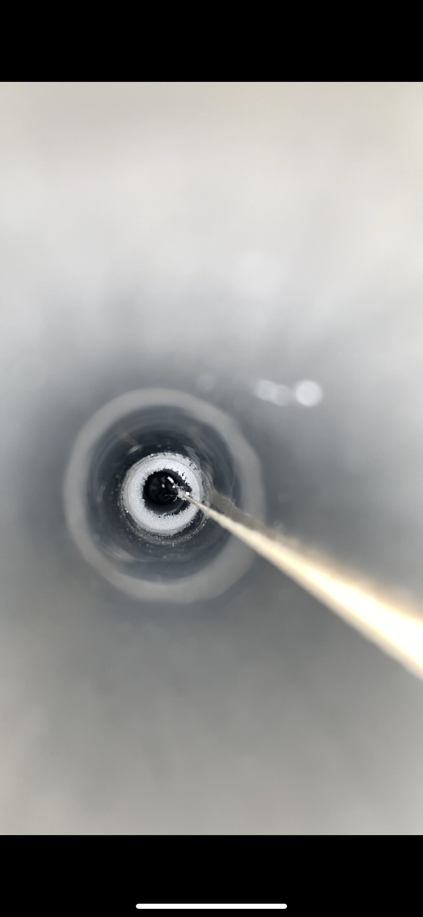
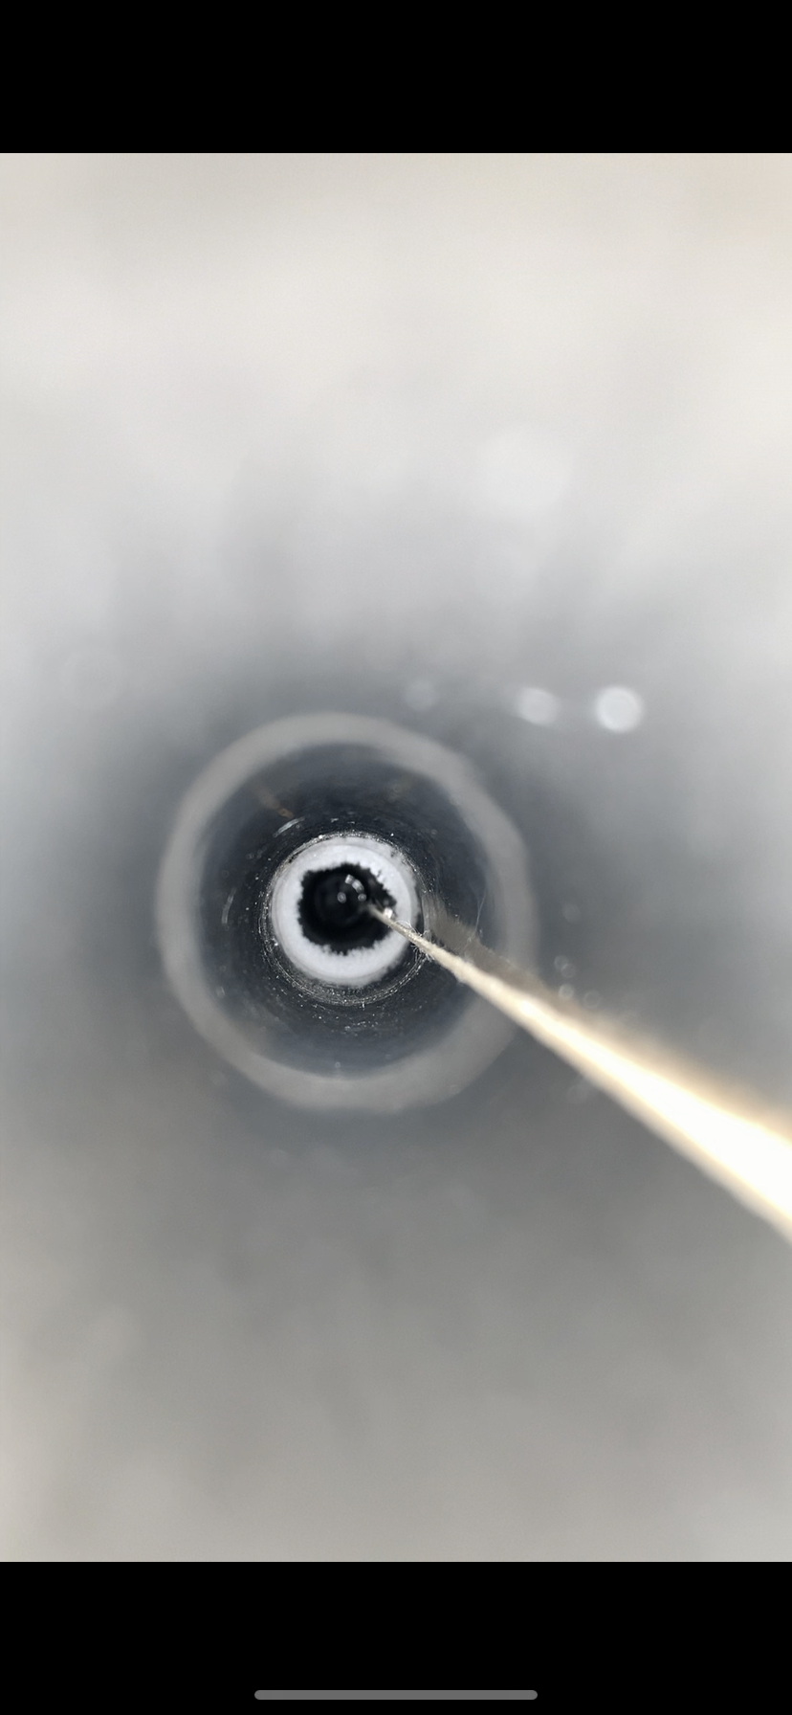






Flushing LN2 to see effect on ice :
Time | 16:00 | 17:00 | 13/06/2023 9:00 | 11:25 | 13:00
Right Side (DS2)
Left Side (DS4)
T shaped gN2 pipe | YES | YES | YES | YES | YES
gN2 Total flow | 250L/h | 250L/h | 250L/h | 250L/h | 250L/h
LN2 in tube | 56cm from top -> position 564 |  |  |  | 58 from top -> position 562
% LN2 in tank | ~ 80% | ~ 80% | 75% | ~98% | 98.4%
Pictures are cropped to be visible so do not pay attention on sizes, more on shapes.

Slide 46










Flushing LN2 to see effect on ice :
Time | 14:14 | 15:30 | 17:30 | 14/06 9:30 | 15/06 10:00
Right Side (DS2)
Left Side (DS4)
T shaped gN2 pipe | YES | YES | YES | YES | YES
gN2 Total flow | 250L/h | 250L/h | 120L/h | 120L/h | 120L/h
LN2 in tube |  | 54cm so position 566 | 52 so position 568
% LN2 in tank | 98% | 97,5% | 99% | 95% | 89%
Pictures are cropped to be visible so do not pay attention on sizes, more on shapes.

Slide 47








Flushing LN2 to see effect on ice :
Time | 16/06 | 19/06 | 20/06 | 21/06
Right Side (DS2)
Left Side (DS4)
T shaped gN2 pipe | YES | YES | YES | YES
gN2 Total flow | 120L/h | 120L/h | 120L/h | 120L/h
LN2 in tube |  | Position 570 | Position 574 | ?
% LN2 in tank | 99,6% | 83% | 100% | 96%
Pictures are cropped to be visible so do not pay attention on sizes, more on shapes.

